Slide 1
Demo of Prototype for NET-ZERO building - Integrating IoT devices to Sustainability reports
Uttam Kotdiya
Bhumika Kotdiya

Slide 2
Azure IoT Central

Slide 3
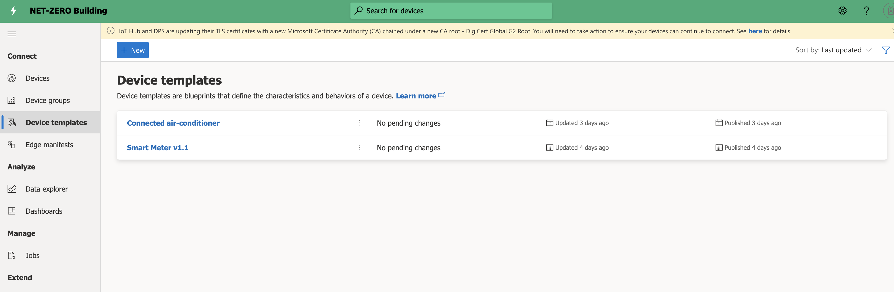
Define Device templates

Slide 4
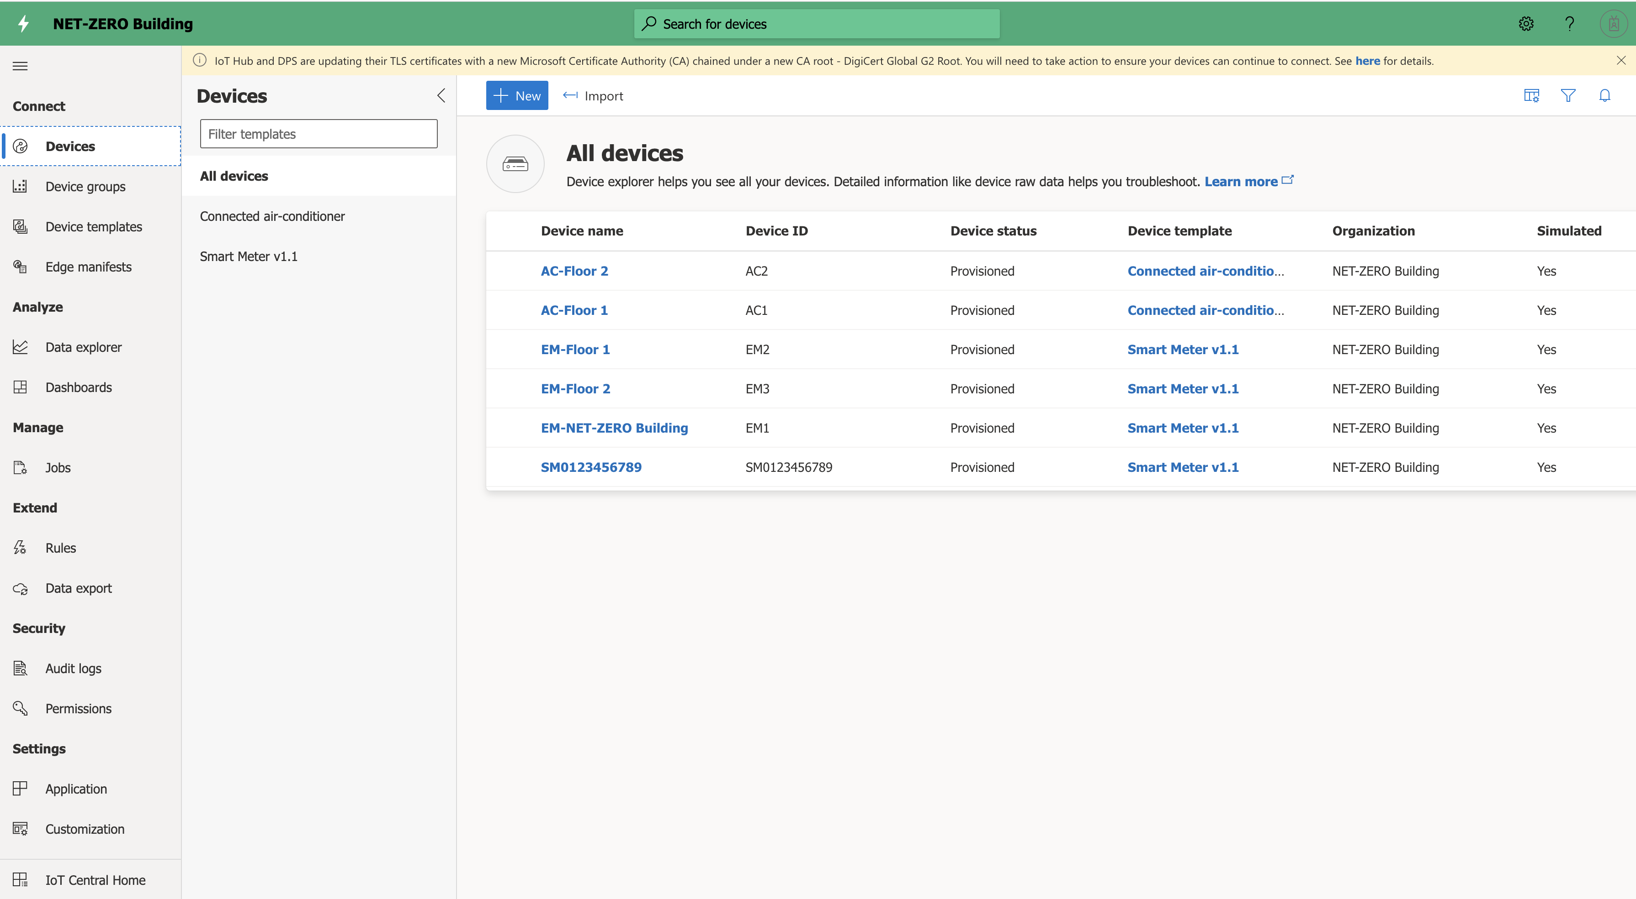
Add Simulated devices

Slide 5
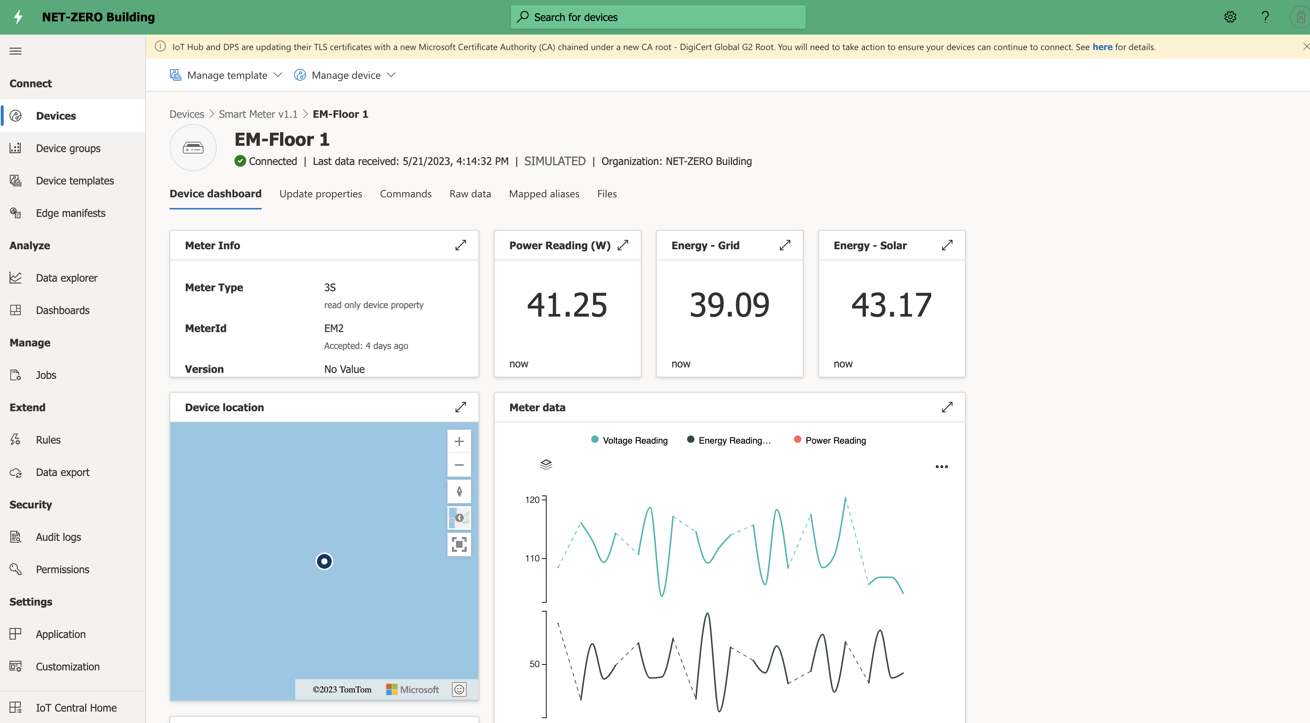
Visualize the Smart meter device data

Slide 6
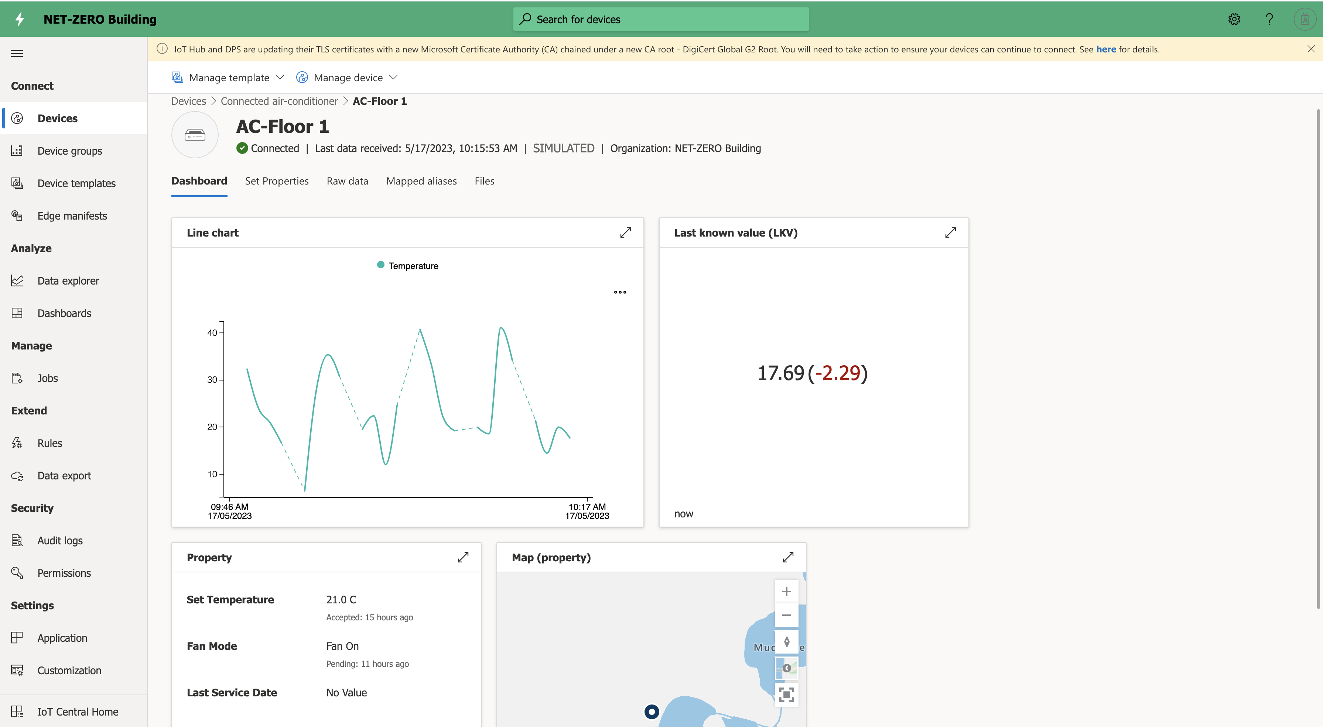
Visualize connected AC device data

Slide 7
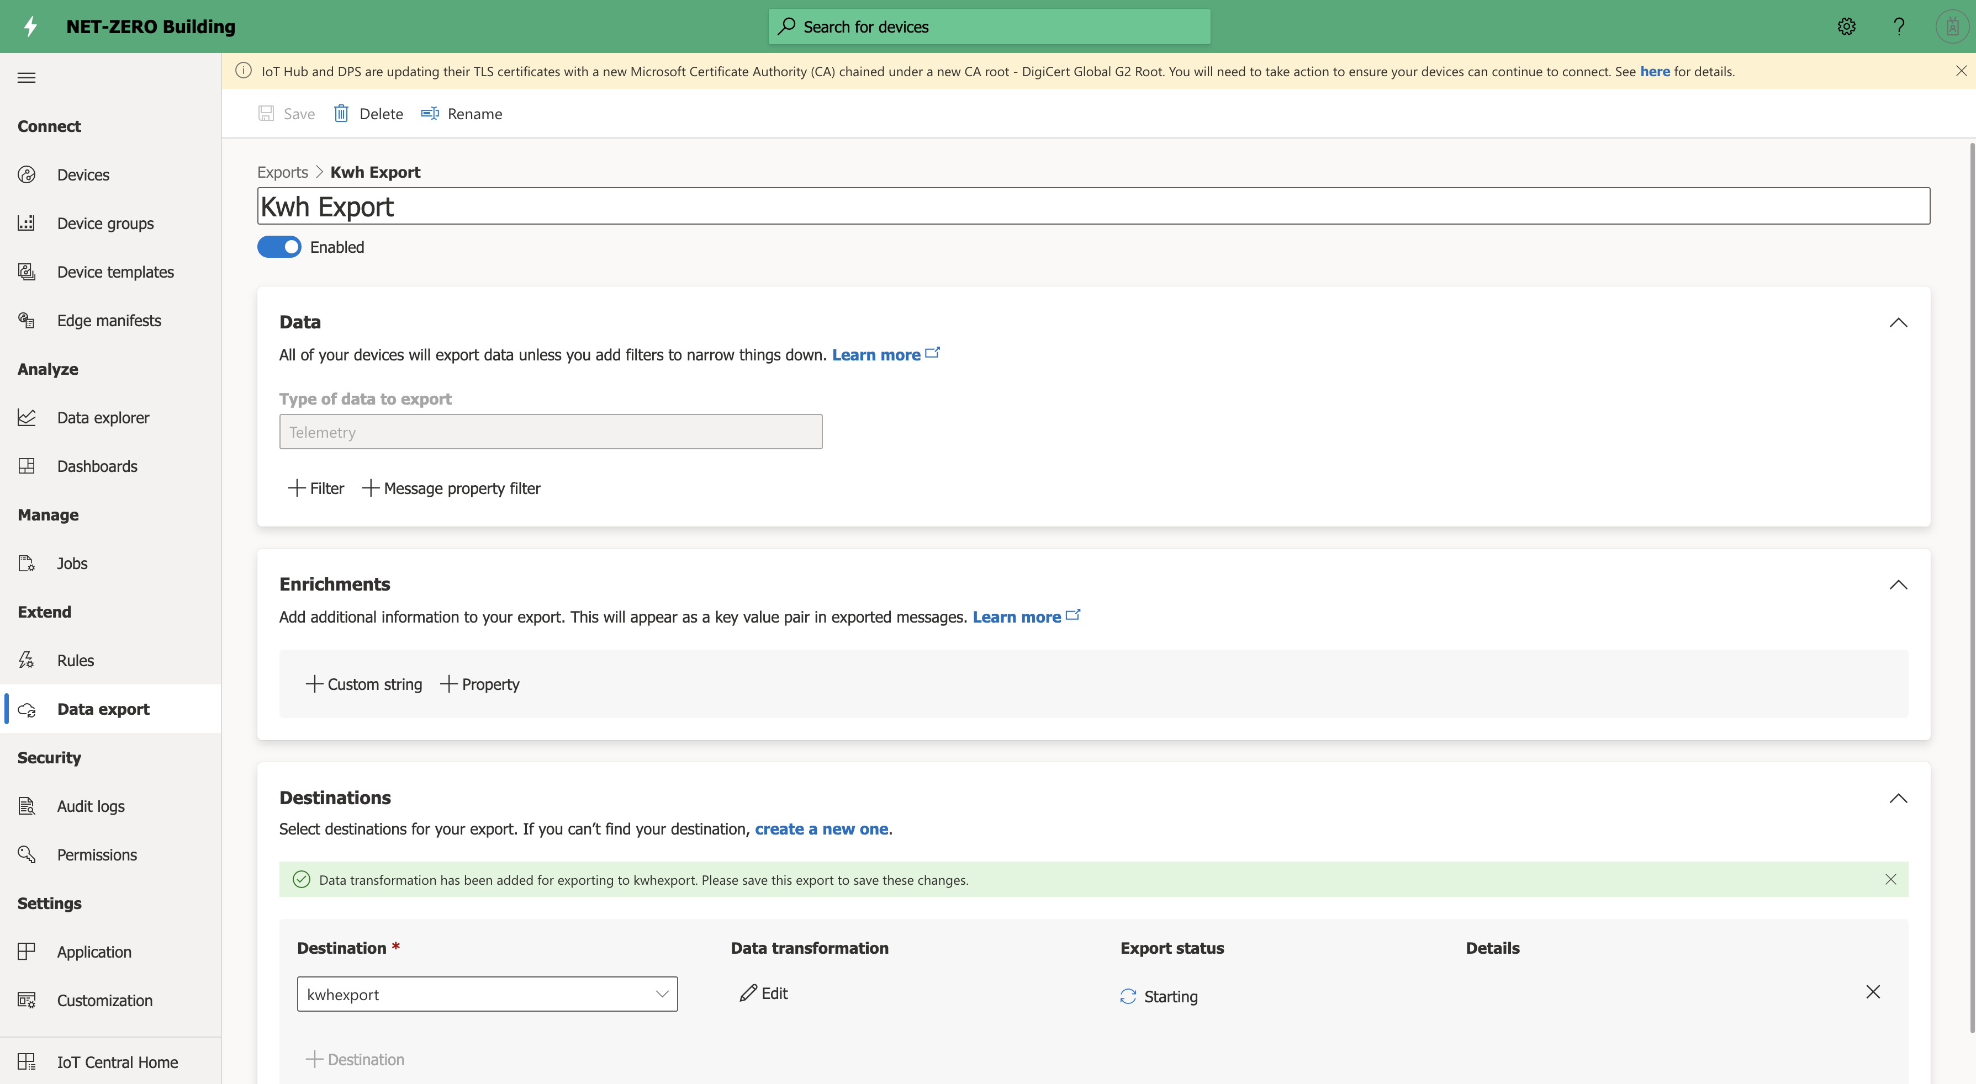
Configure export with transformation

Slide 8
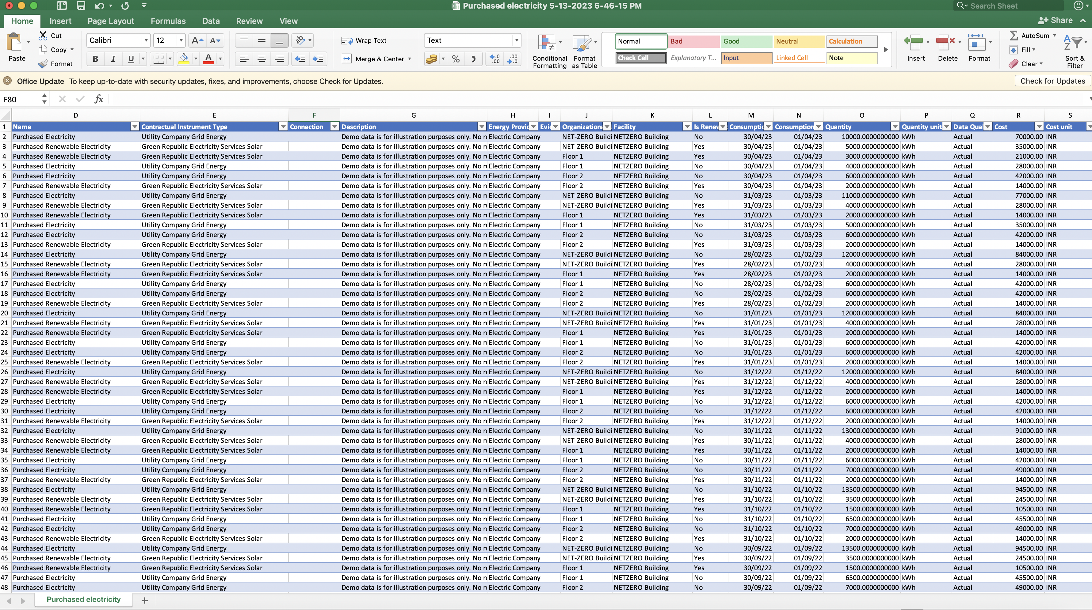
Excel template for Energy

Slide 9
Microsoft sustainability Manager

Slide 10
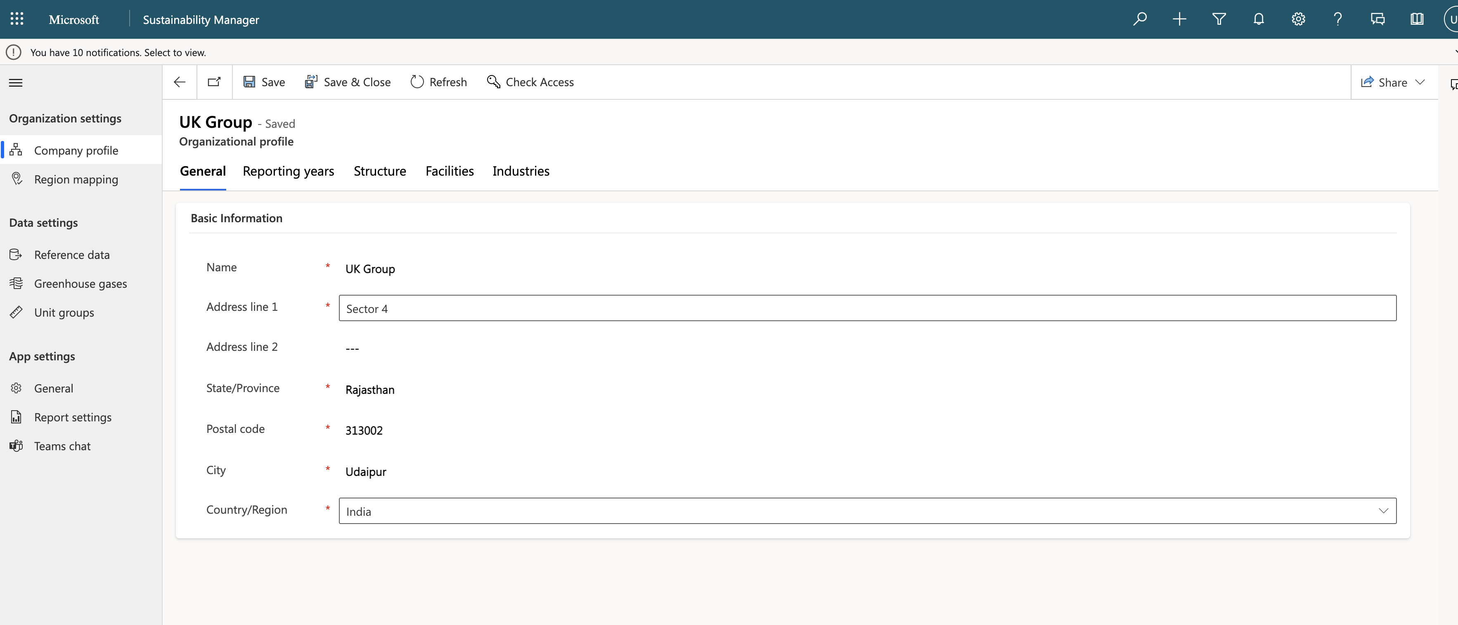
Define Organization

Slide 11
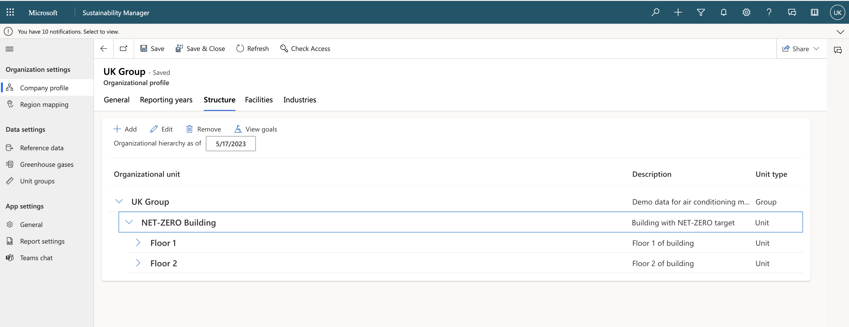
Define structure

Slide 12
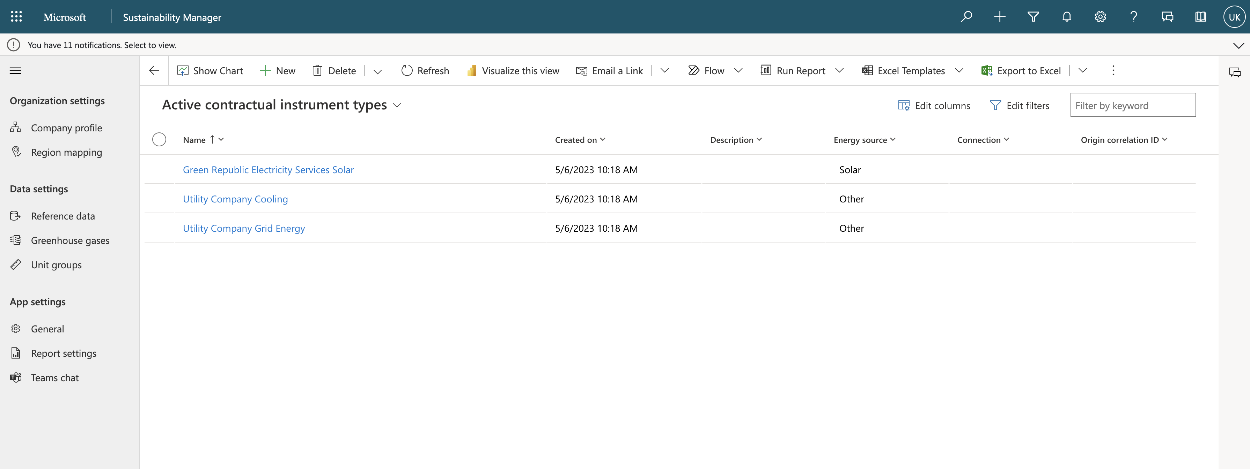
Define contractual instrument type

Slide 13
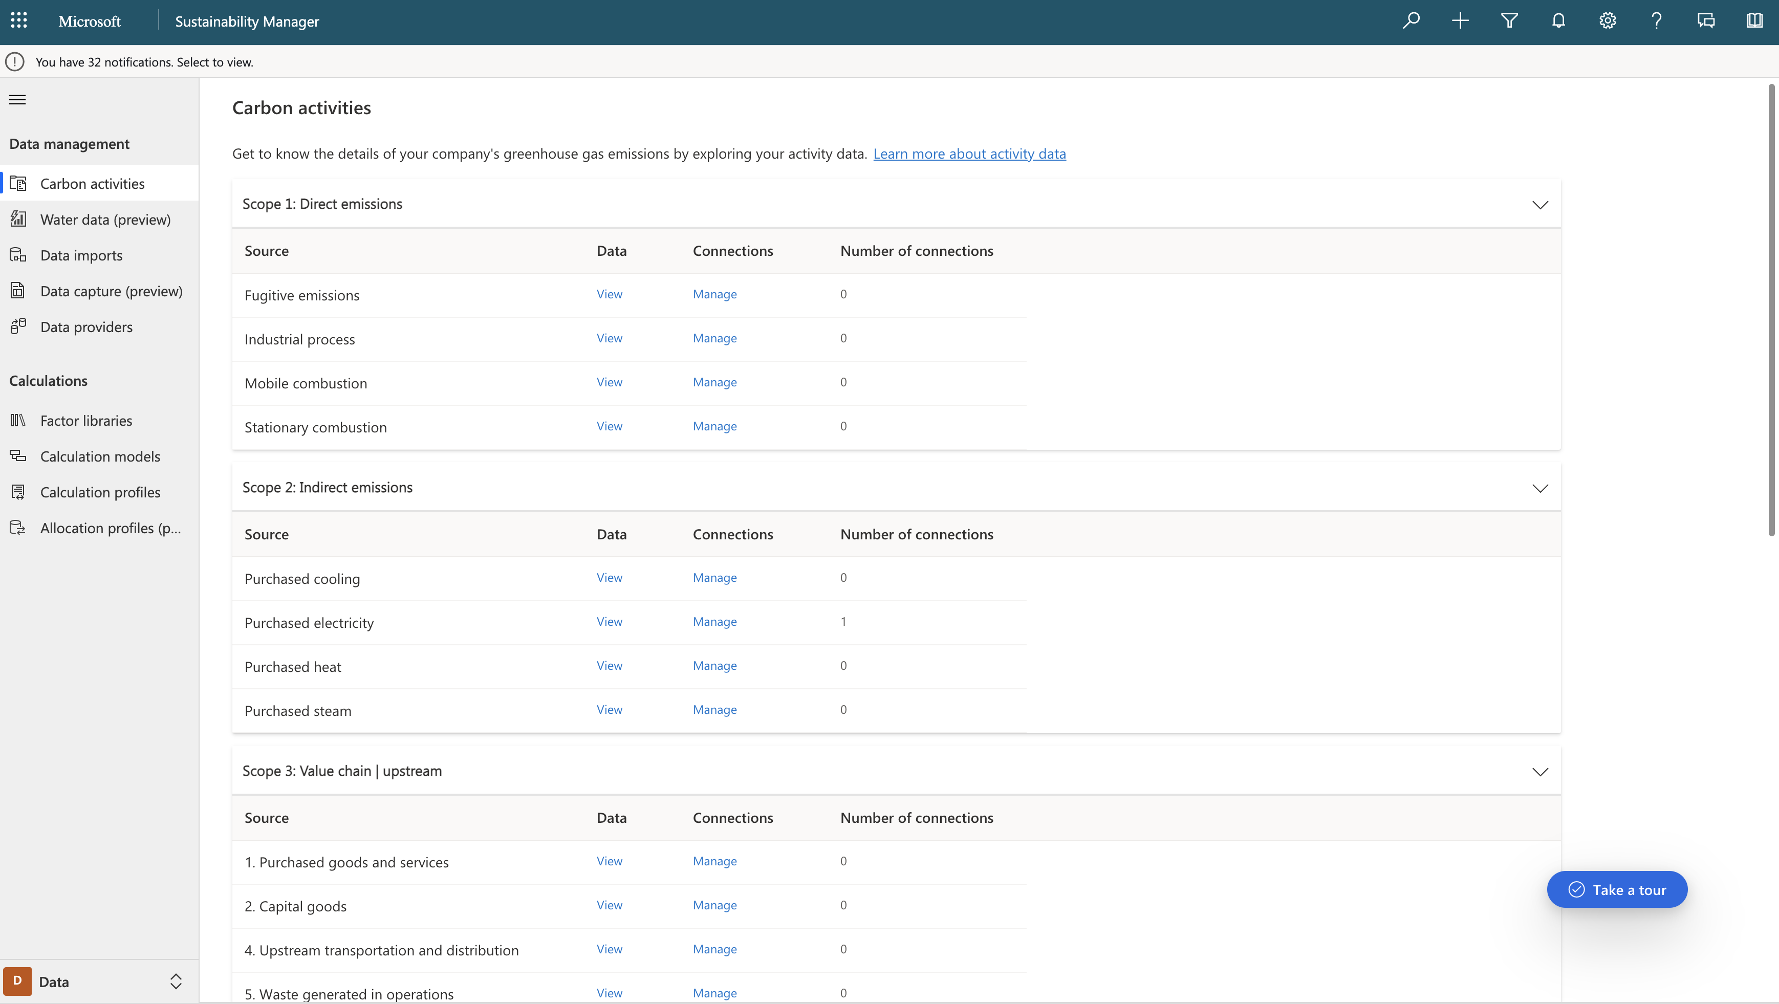
Configure data import - Purchase electricity

Slide 14
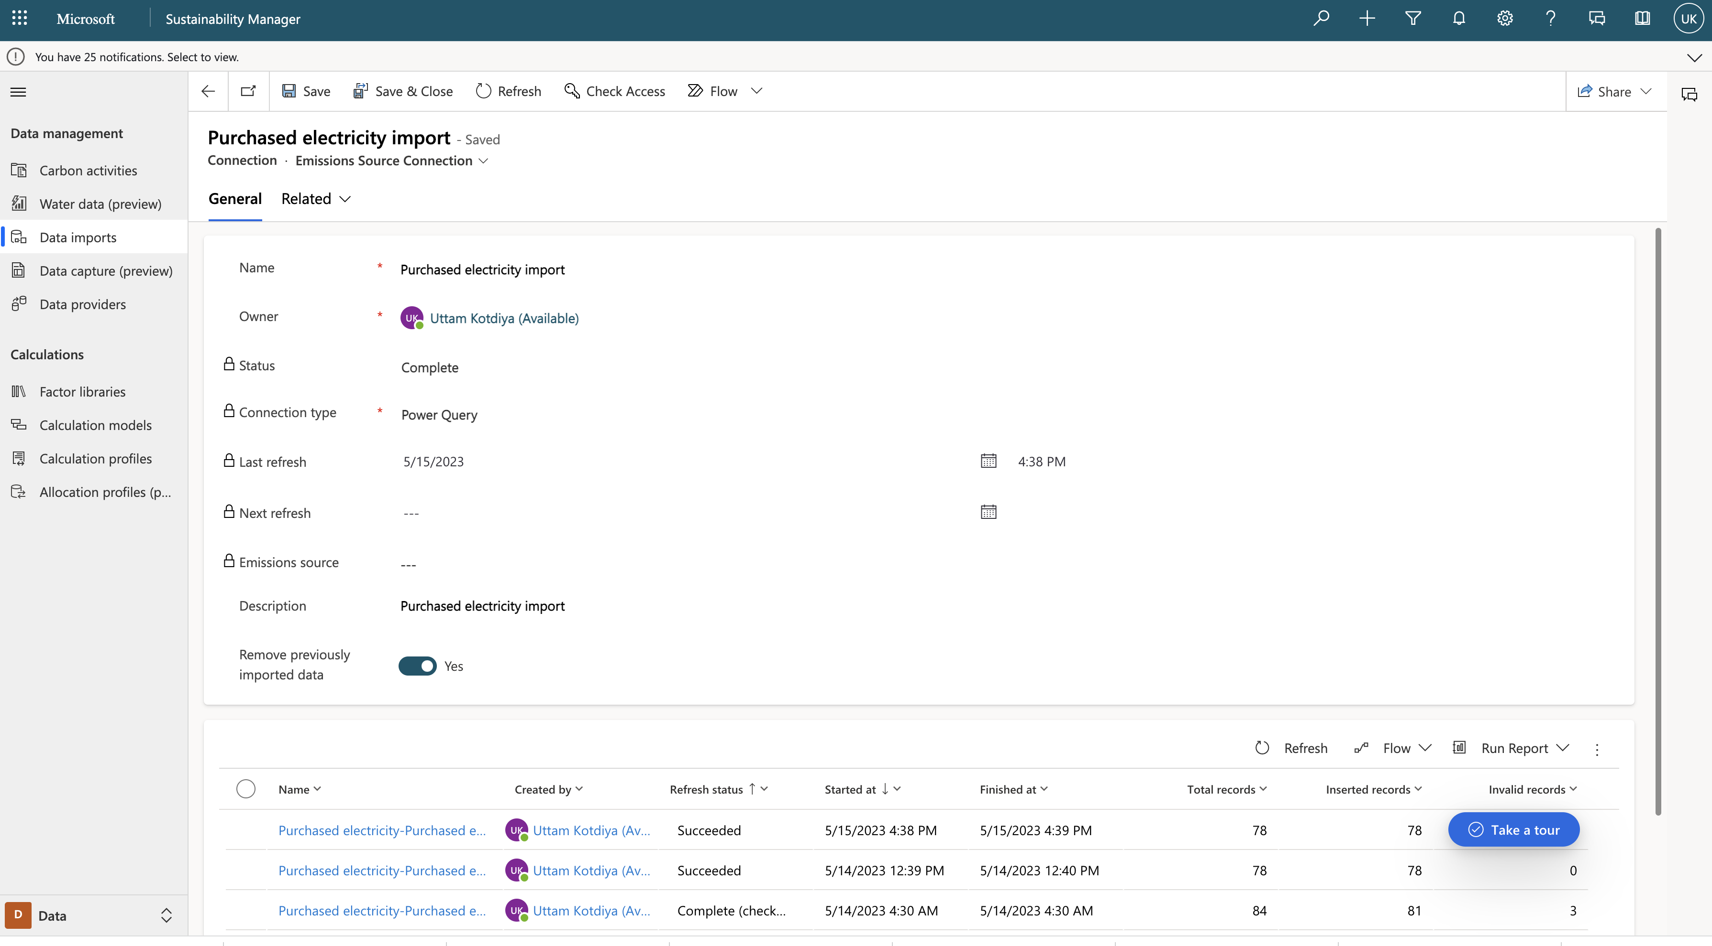
Configure import for purchase electricity

Slide 15
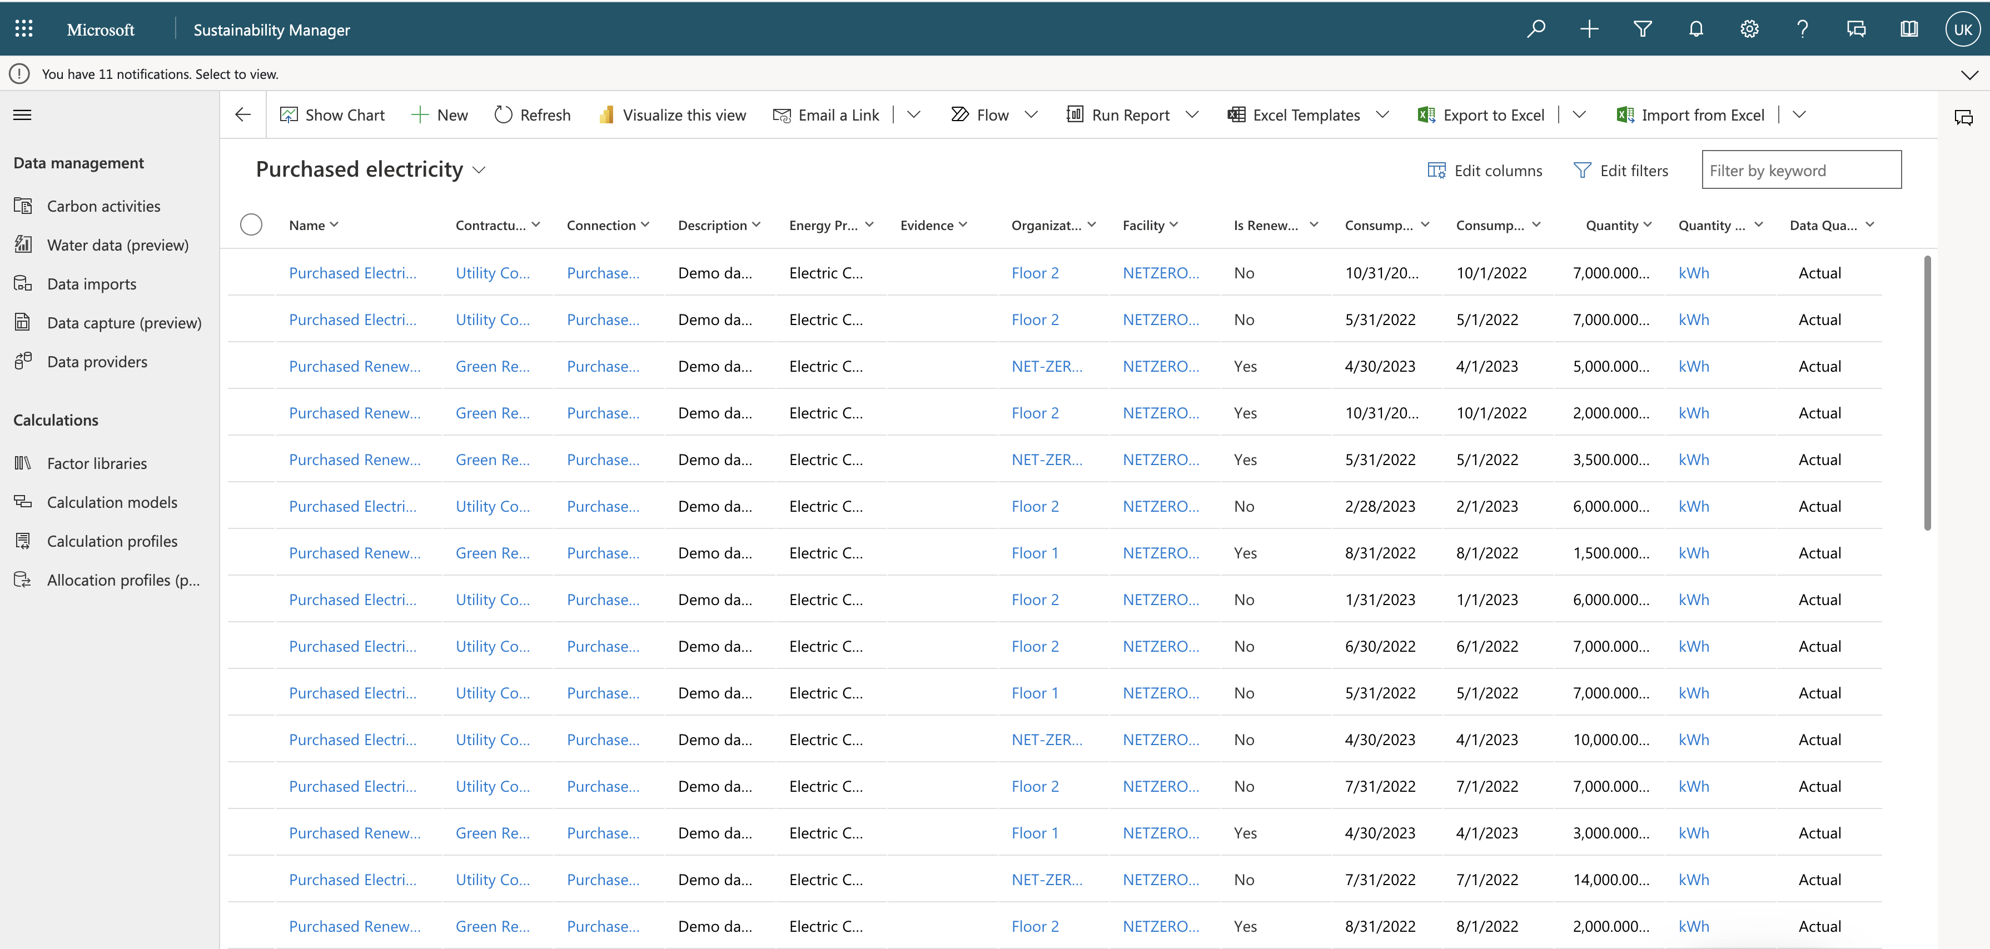
View data after import

Slide 16
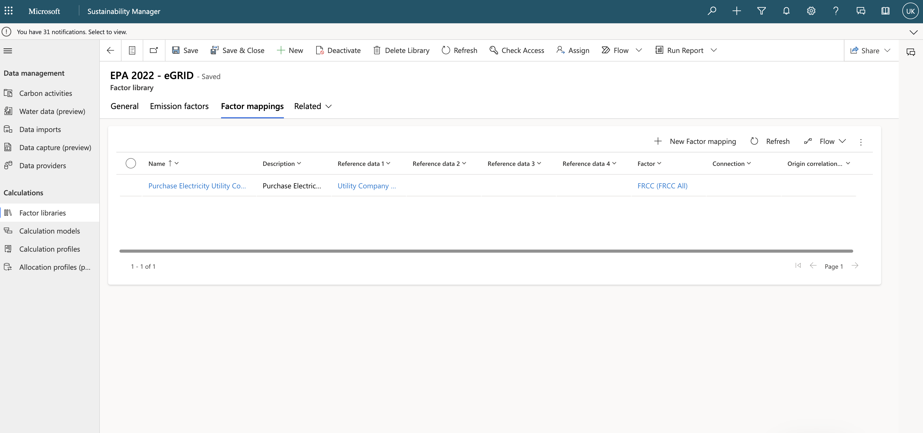
Define factor mapping for eGrid

Slide 17
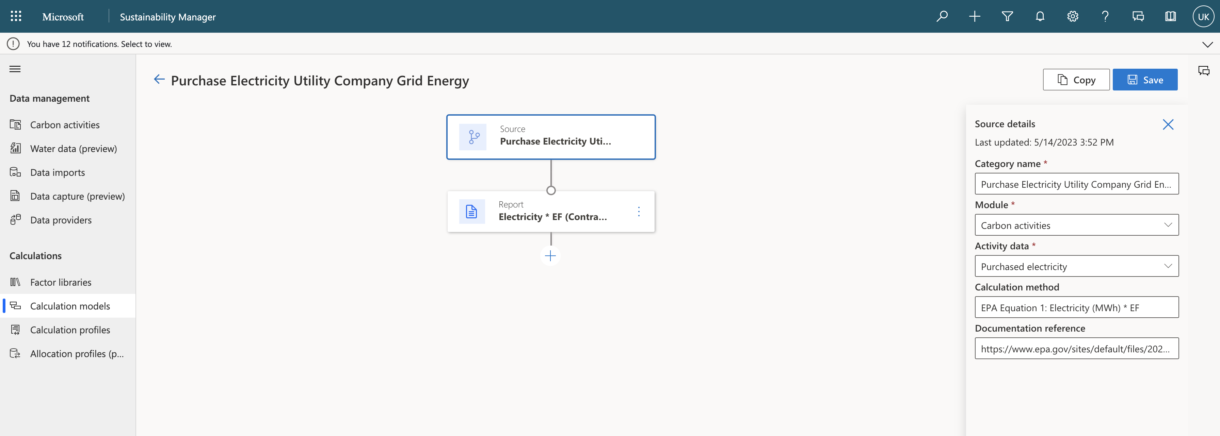
Define calculation model

Slide 18
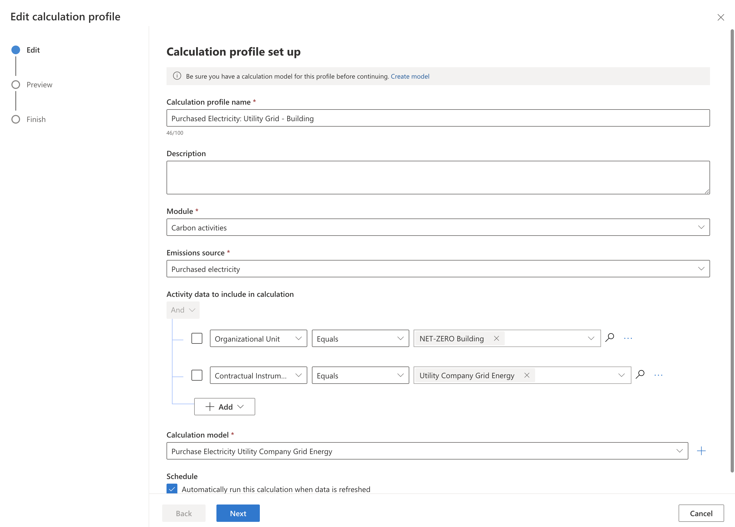
Configure calculation profile

Slide 19
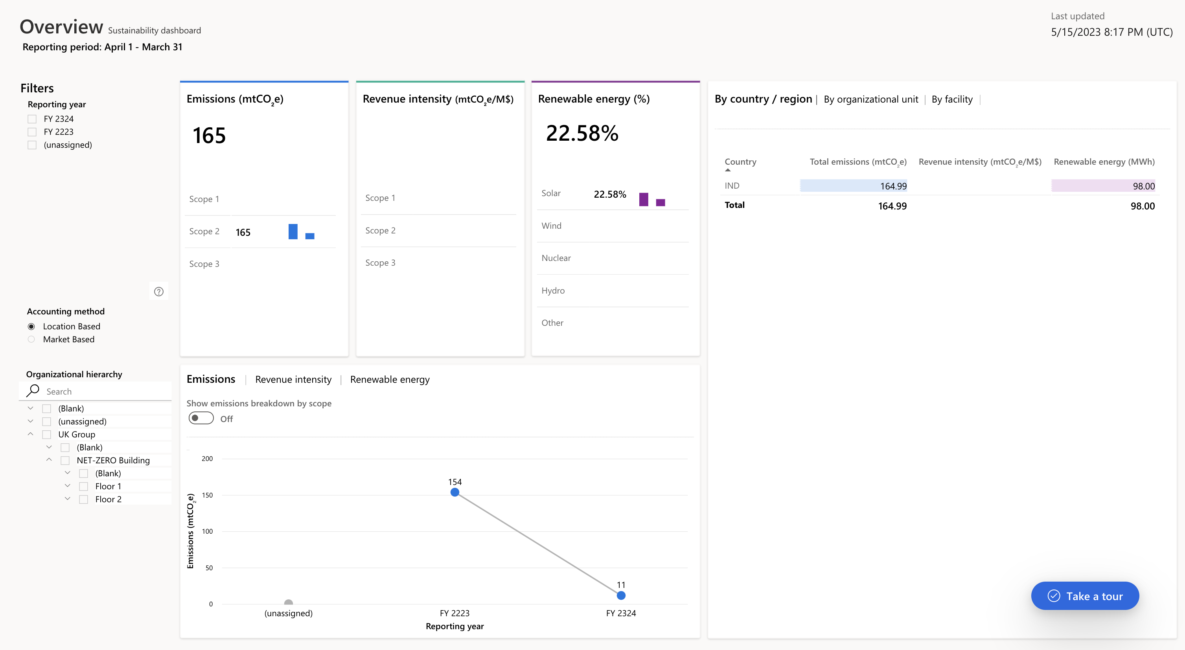
Visualize dashbord - Overview

Slide 20
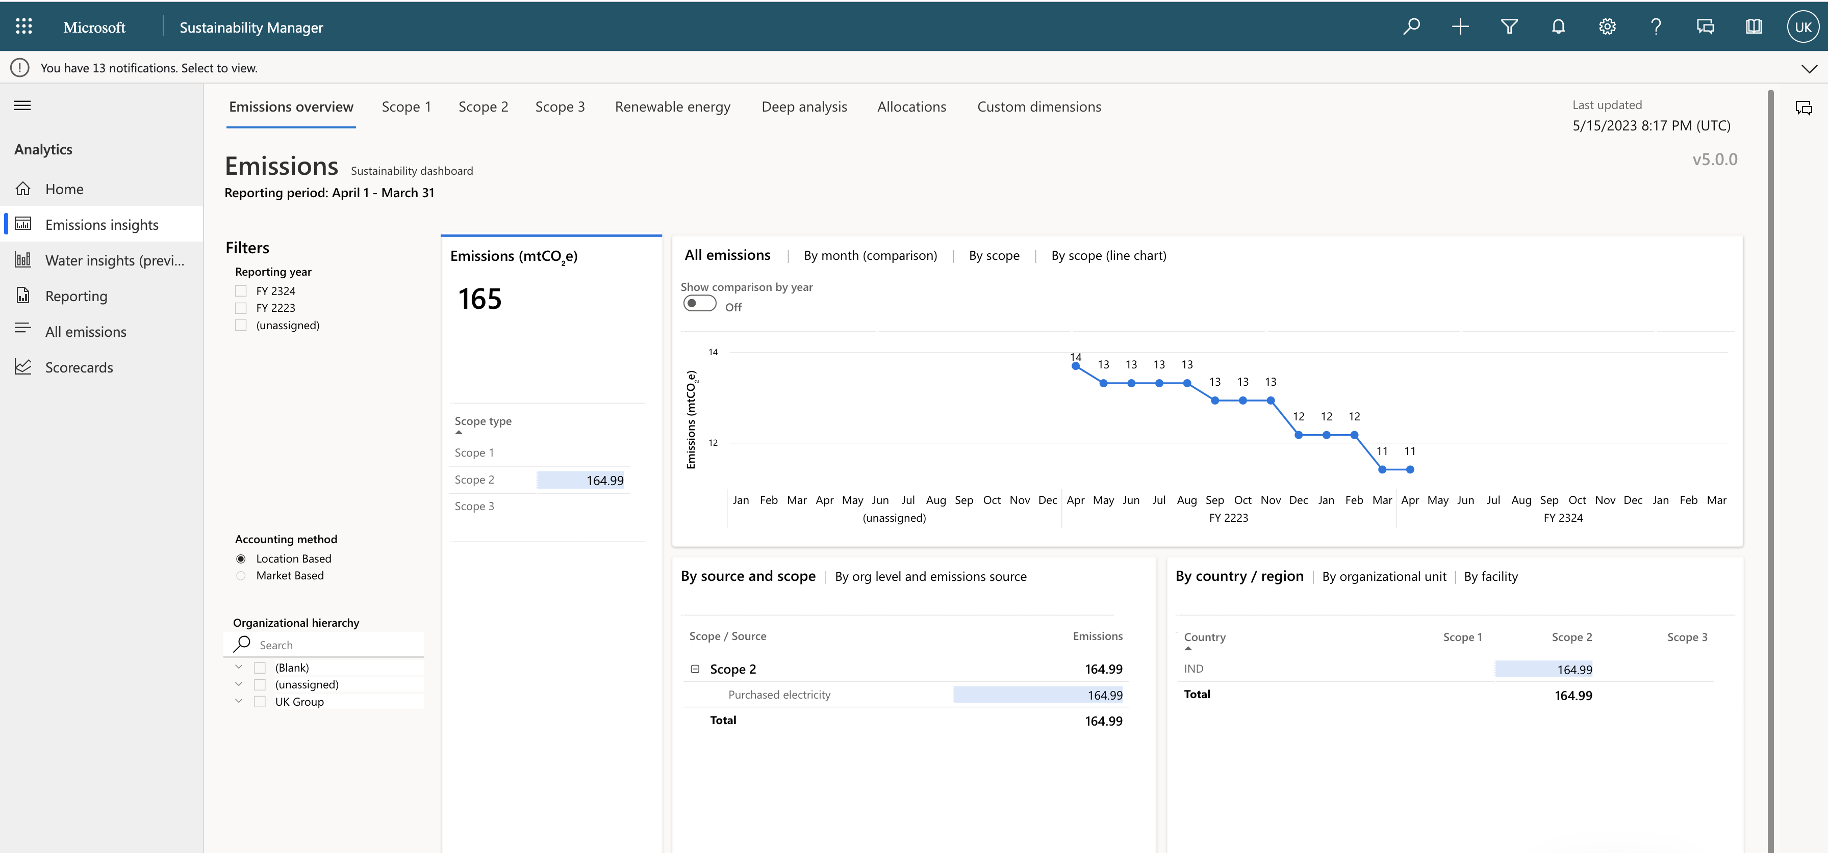
Visualize Emission

Slide 21
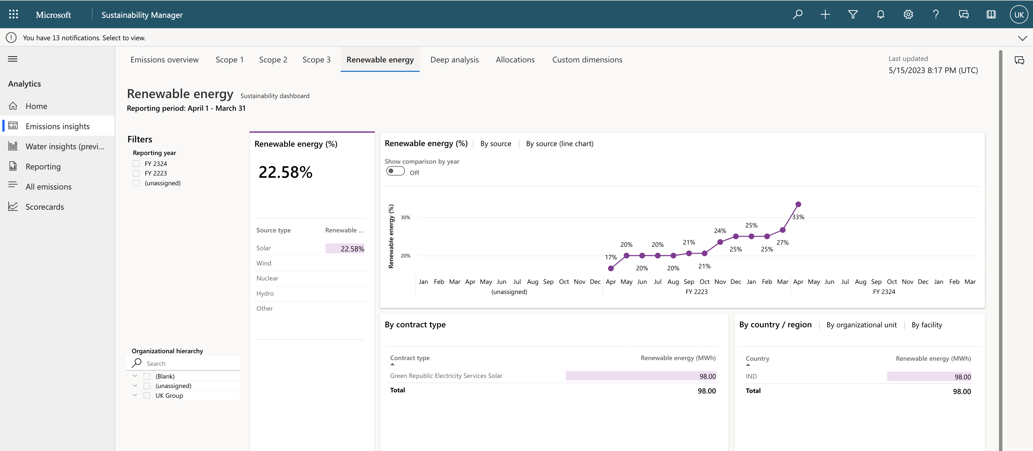
Visualize Renewable energy

Slide 22
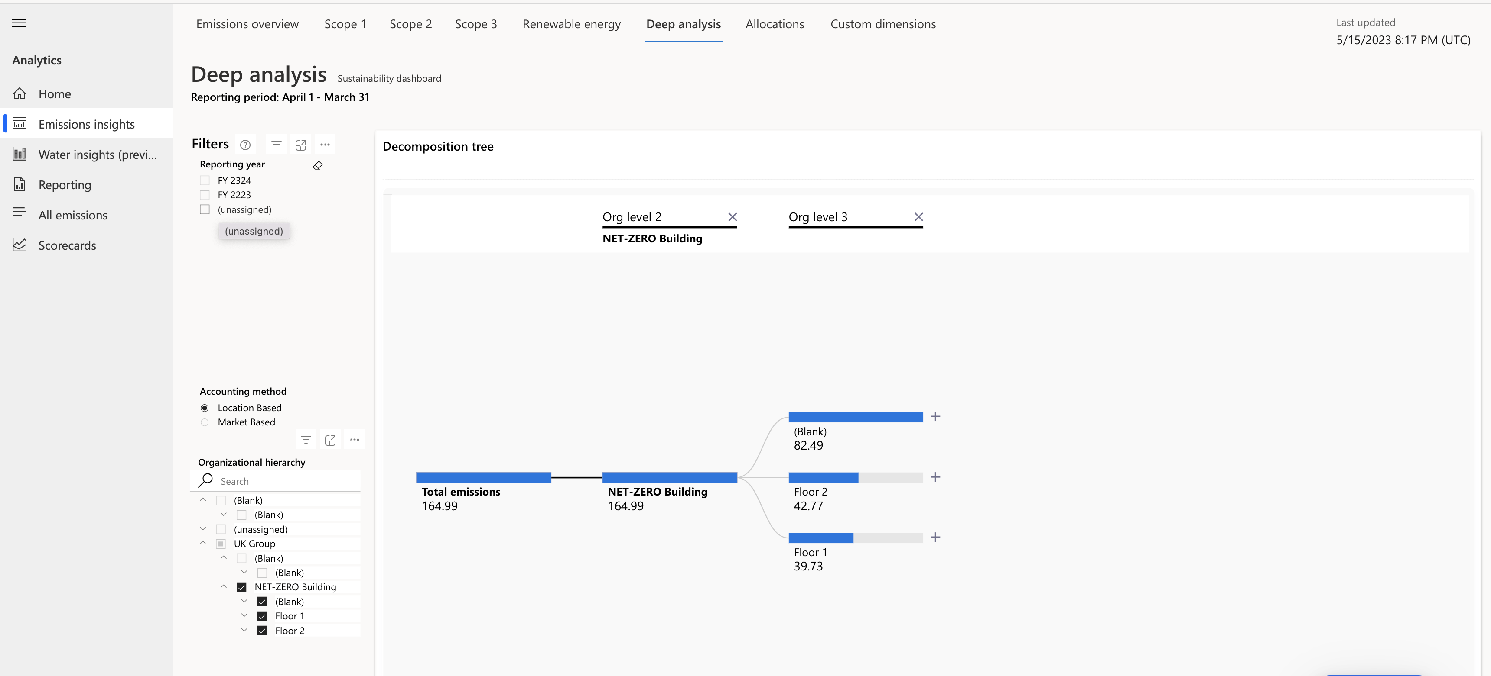
Visualize Organization unit wise emission

